Slide 1
Spiritual Leadership
Leadership in Practice
Scottish Mission Leadership Skills Training Day, 1 February 2026
Christian Salcianu | HIM Research

Slide 2




Slide 3
“You know that the rulers in this world lord it over their people, and officials flaunt their authority over those under them. But among you it will be different.
Whoever wants to be a leader among you must be your servant, and whoever wants to be first among you must become your slave.”
Matthew 20:25-27

Slide 4


Slide 5
“A person can receive only what is given them from heaven.”
John 3:27

Slide 6
1. THE BIBLICAL PERSPECTIVE

Slide 7
1. God is the ultimate leader
A Biblical Perspective of Leadership

Slide 8
1. God is the ultimate leader 2. He calls people to share his work
A Biblical Perspective of Leadership

Slide 9
1. God is the ultimate leader 2. He calls people to share his work 3. His leaders will show servant leadership
A Biblical Perspective of Leadership

Slide 10
1. God is the ultimate leader 2. He calls people to share his work 3. His leaders will show servant leadership 4. Jesus Christ is the perfect leader
A Biblical Perspective of Leadership

Slide 11
1. God is the ultimate leader 2. He calls people to share his work 3. His leaders will show servant leadership 4. Jesus Christ is the perfect leader 5. The Holy Spirit leads God’s people
A Biblical Perspective of Leadership

Slide 12
2. APOSTOLICITY

Slide 13
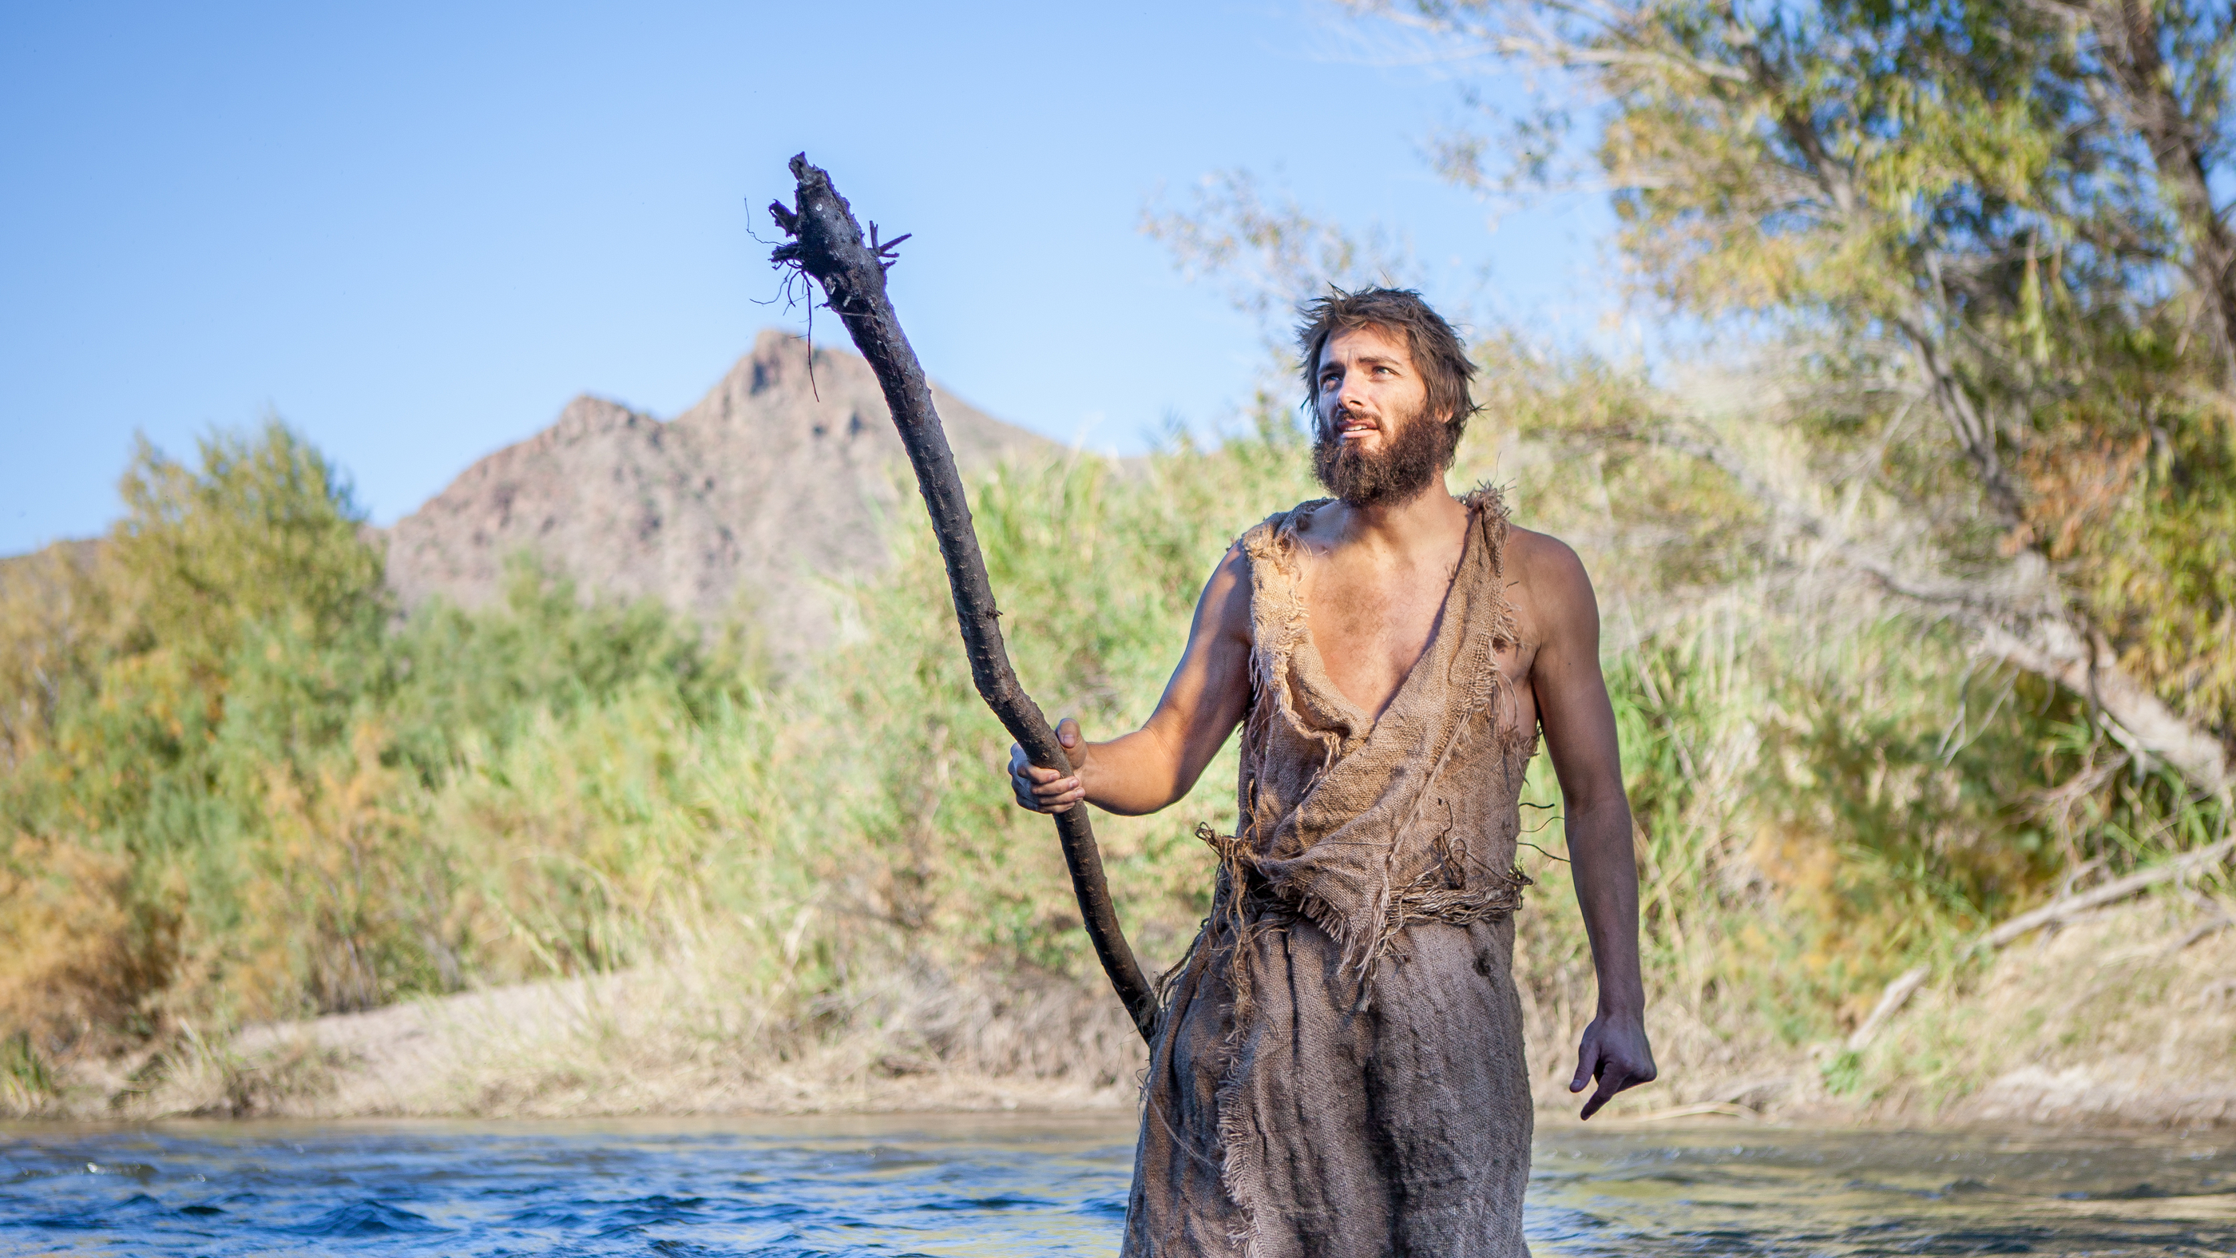
“A man sent by God” (John 1:6)

Slide 14
3. FOLLOWING A DIVINE PLAN

Slide 15

“I have come down from heaven not to do my will but to do the will of him who sent me.” (John 6:38; see also 5:36; 8:42; 9:36; 14:31)

Slide 16
1. Divine action
The Son does “what he sees his Father doing” (John 5:19; see also 5:30)

Slide 17
1. Divine action 2. Divine instruction
“My teaching is not My own, but His who sent Me” (John 7:16; see also 7:28; 8:26, 28, 38; 12:49, 50; 14:10, 24)

Slide 18
1. Divine action 2. Divine instruction 3. Divine timing
From “my hour has not yet come” (2:4; 7:6, 8, 30; 8:20) to the culmination when “the hour has come” (12:23, 27; 13:1, 31; 17:1) and “it is finished” (19:28, 30).

Slide 19
“[God] asks leaders to walk with him so intimately that when he reveals his agenda, they immediately adjust their lives and their organizations to his will and the results bring glory to God.
This is not the model many religious leaders, let alone business or government officials, follow today, but it encompasses what biblical leadership is all about.” Spiritual Leadership, Blackaby

Slide 20
4. HUMILITY

Slide 21
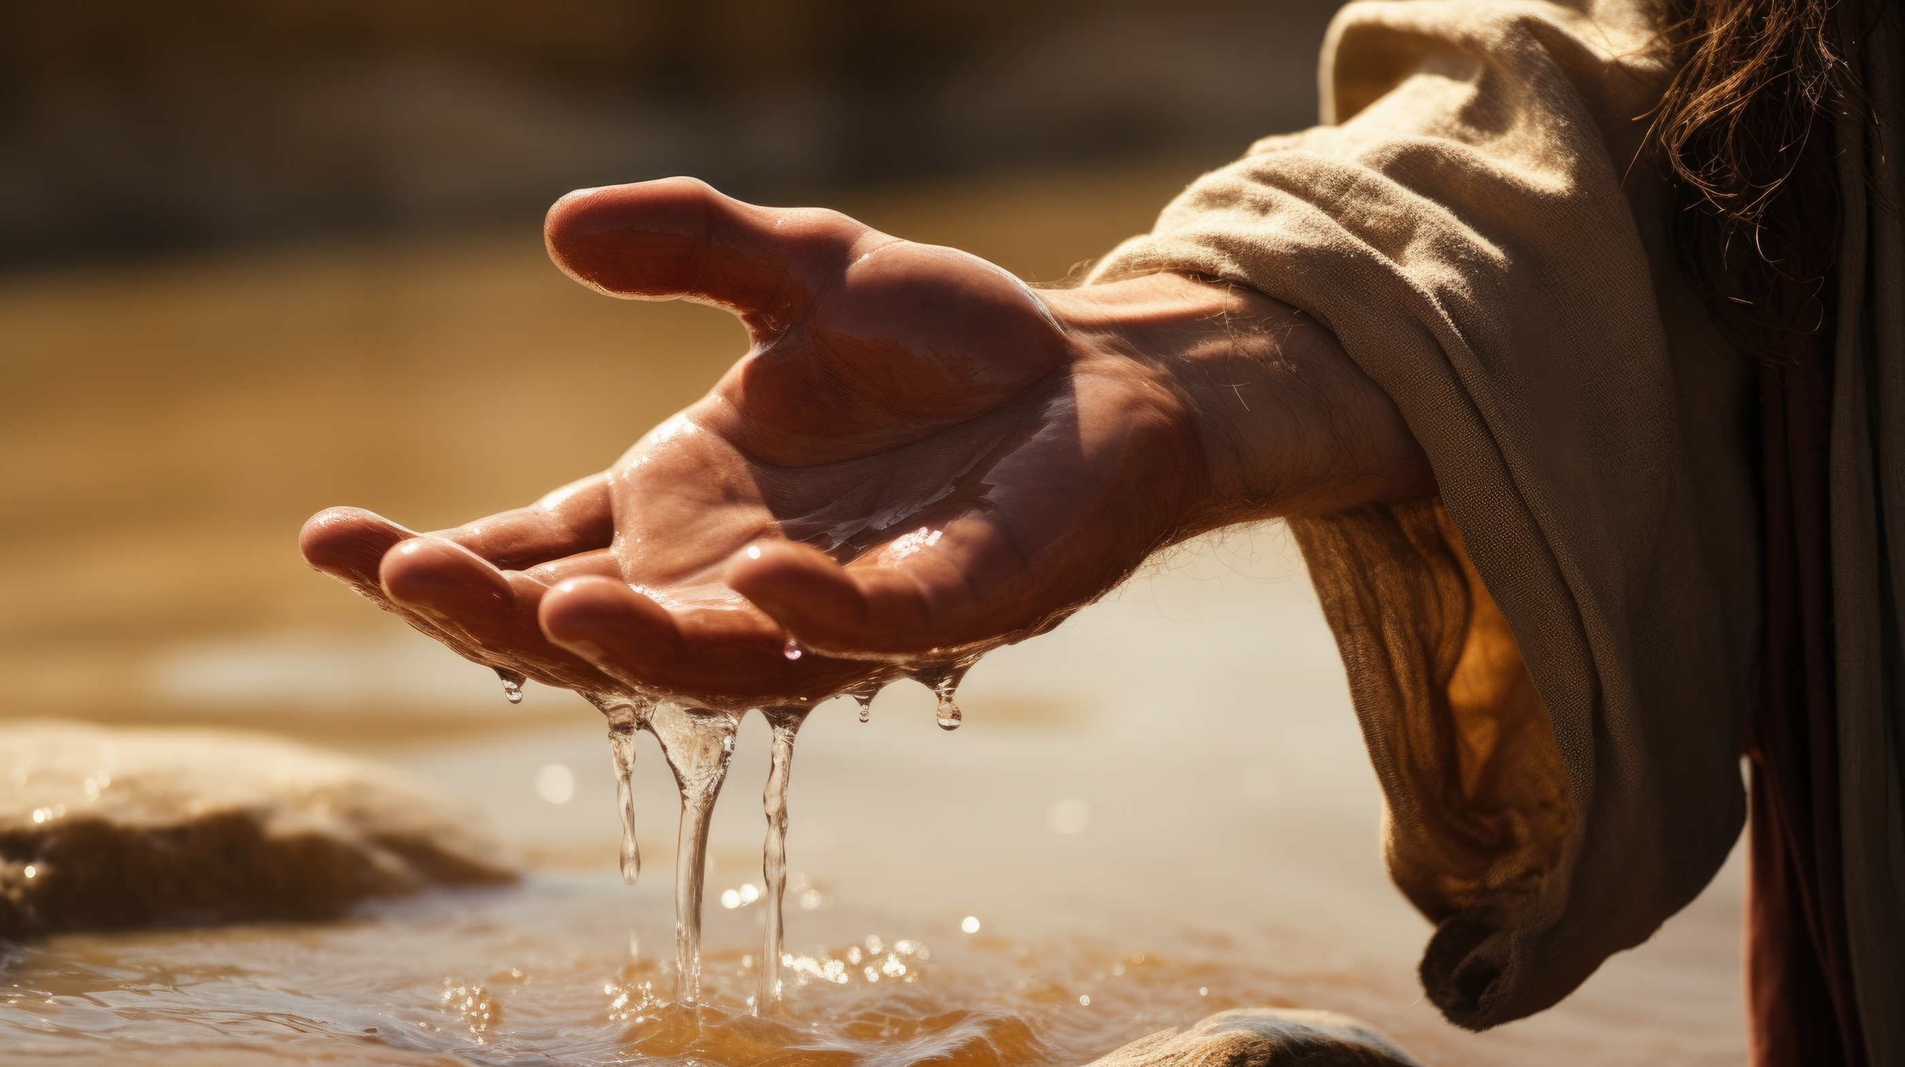
“I am not… ” (John 1:20)

Slide 22
5. KENOSIS
Self-Emptying

Slide 23

“He must become greater; I must become smaller.” (John 3:30)

Slide 24

“Who, being in very nature God, did not consider equality with God something to be used to his own advantage; rather, he made himself nothing by taking the very nature of a servant, being made in human likeness. And being found in appearance as a man, he humbled himself by becoming obedient to death—even death on a cross!” (Philippians 2:5–8)

Slide 25
6. FILLED WITH THE SPIRIT
The Gifts & The Fruit

Slide 26
“Spiritual leaders are not made by man, nor any combination of men. Neither conferences, not synods, nor councils can make them, but only God.” The Soul Winner’s Secret, Brengle
“There is no such thing as a self-made spiritual leader. […] He is penetrated, saturated, and empowered by the Holy Spirit.” Spiritual Leadership, Sanders
“Leadership formulas, or methodologies, do not create spiritual leaders.” Servants and Friends, Wibberding
“Spiritual leaders are directed by the Holy Spirit.” Spiritual Leadership, Blackaby

Slide 27
“Leadership role was determined by spiritual giftedness and a spiritual character that demonstrated Christ-like relational behavior.
These two Spirit-given and interwoven qualifications – character and competence – establish the spiritual foundation for leadership in the New Testament.” Servants and Friends, Patterson

Slide 28
“We go with the Holy Spirit, guided by His counsel, taught through His providential instruction, empowered by His presence and gifts, filled by His intimate indwelling presence.
To lead without the presence of the Holy Spirit denies the biblical foundation of leadership.” Servants and Friends, Bell

Slide 29
7. SPIRIT-LED

Slide 30
“He [the Holy Spirit] will teach you all things.” John 14:26
“He will guide you into all the truth.” John 16:13
“[He] will remind you of everything I have said you.” John 14:26
“The world cannot accept him.” John 14:17

Slide 31
Spiritual Leadership
Christian Salcianu | HIM Research

