Slide 1
Vision, Mission, and Strategy
Leadership in Practice
Scottish Mission Leadership Skills Training Day, 1 February 2026
Christian Salcianu | HIM Research

Slide 2


Slide 3
“God’s work, done in God’s way, will never lack
God’s supplies.”
Hudson Taylor

Slide 4


Slide 5
“A person can receive only what is given them from heaven.”
John 3:27

Slide 6
“What you see, write in a book and send it to the seven churches.”
Revelation 1:11

Slide 7
“What you see, write in a book and
send it to the seven churches.”
See
Write
Send
Receive
Articulate
Do
VISION
MISSION
STRATEGY
The Father
Jesus Christ
The Holy Spirit

Slide 8
1. THE VISION

Slide 9

VISION

Slide 10
“Then Jesus said to Simon,
‘Don’t be afraid; from now on
you will fish for people.’
So they pulled their boats up on shore,
left everything and followed him.”
(Luke 5:10-11)

Slide 11
“One night the Lord spoke to Paul in a vision:
‘Do not be afraid; keep on speaking,
do not be silent. For I am with you, and no one is going to attack and harm you, because
I have many people in this city.’
So Paul stayed in Corinth for a year and a half, teaching them the word of God.”
(Acts 18:9-11)

Slide 12
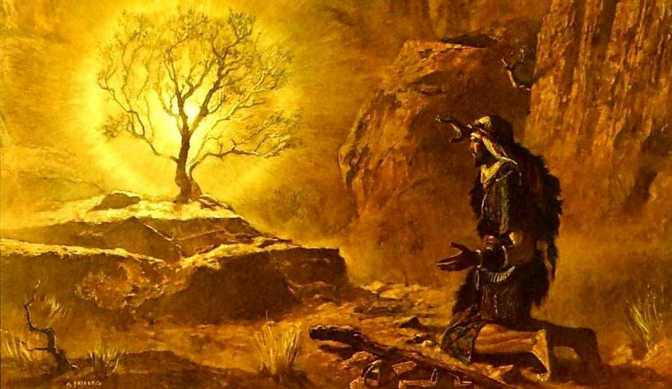

Slide 13
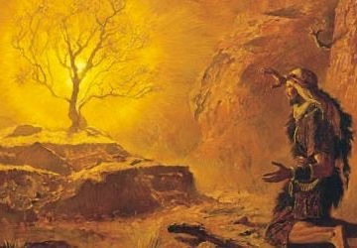
“And God said,
‘I will be with you. And this will be the sign to you that it is I who have sent you: When you have brought the people out of Egypt, you will worship God on this mountain.’”
(Exodus 3:12)

Slide 14

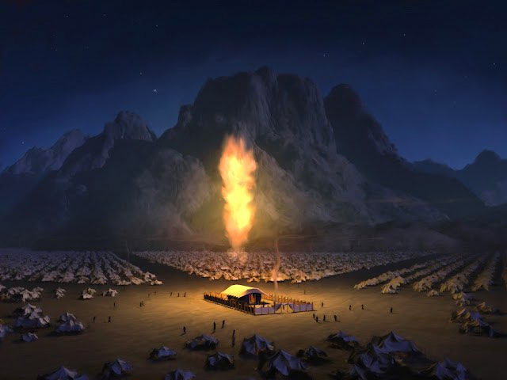

Slide 15
VISION
    Clarity: “Vision is clear.” It answers “What?” / “Where to?”
    Source: It is supplied by God.
    Focus: Future, projecting a God-ordained reality.
    Scope: Higher than any human imagination.
    Impact: No to status quo. A desired change.

Slide 16
2. THE MISSION

Slide 17

MISSION

Slide 18
“God did not send his Son into the world to condemn the world, but to save the world through him.” (John 3:17)
“The Son of Man came to seek and to save the lost.”
(Luke 19:10)
“Do not think that I have come to abolish the Law or the Prophets;
I have not come to abolish them but to fulfill them.” (Matthew 5:17)
“The Son of Man did not come
to be served, but to serve, and
to give his life as a ransom
for many.” (Mark 10:45)

Slide 19
MISSION
    Clarity: It responds to “Why?”/“What for?” (raison d’être)
    Source: Mandate from God, embodied by Jesus.
    Focus: Vision-focused, present-tense declaration.
    Scope: Universally applicable (entire organisation).
    Impact: Alignment for a cause.

Slide 20
VISION
MISSION
A picture | A movie
The destination | The journey
In the future | In the present
Higher (ideal) | Human (doable)
God-given | Human and divine partnership
Acts as a magnet | Acts as a propeller
Revelation | Commandment
Excitement & motivation | Meaning & purpose
Joyful | Painful
God-focused | Vision-focused

Slide 21
3. THE STRATEGY

Slide 22

STRATEGY

Slide 23

1 Samuel 17

Slide 24
Acts 17

Slide 25
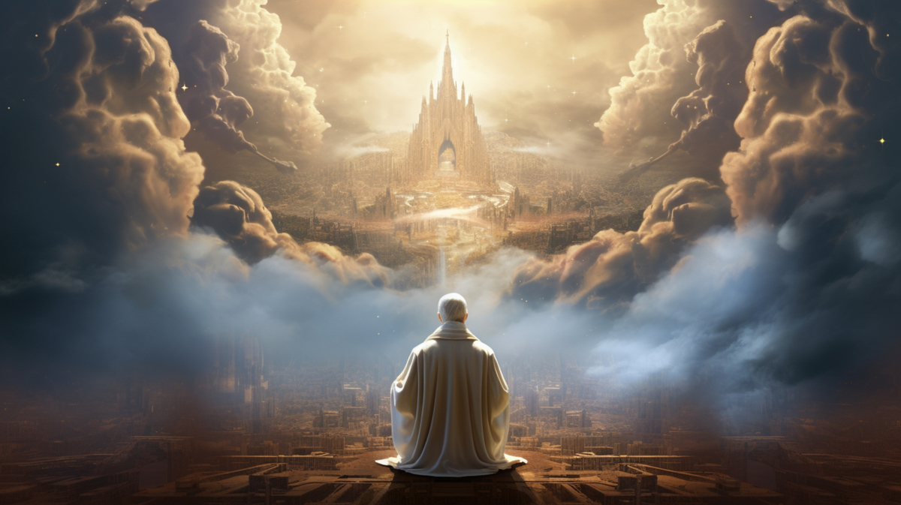
2 Thessalonians 2

Slide 26

Matthew 28, Mark 16
Luke 24, John 20

Slide 27
STRATEGY
    Clarity: It answers the question “How?” (subject to change)
    Source: The Holy Spirit’s leading (team, data, reflections).
    Focus: Mission-focused, values-driven, results-oriented.
    Scope: A step by step approach (teams).
    Impact: Incremental changes.

Slide 28
MISSION
STRATEGY
Fixed (in stone) | Fluid (adaptable)
Universal (in time and space) | Specific (contextual, cultural)
Enduring (rarely changes, if ever) | Expiring (must be reviewed periodically)
Driven by heart | Driven by head
Defined by the calling | Defined by the guidance
Owned by everyone (all members) | Directed by leaders (team)
Focus on alignment (unity) | Focused on execution (many methods)
Commitment & sacrifice | Planning & resources allocation
Qualitative (faith, deep, direction) | Quantitative (growth, metrics)
Vision-focused | Mission-focused

Slide 29
WORDS (of caution)

Slide 30
RADICAL
PRAYER, MISSION
URGENT
APPEAL, DECISION
TOTAL
MEMBER INVOLVEMENT
FINAL
HOPE, CHANCE

Slide 31
WORDS (of clarity)

Slide 32
MISSION
VISION
STRATEGY
What / Where to? | Why? What for? | How?
Long term destination | Core mandate | Action plan
Mental image | Deep (internalised) | Implementation
Desired future | Buying in | Execution
Guiding purpose | Sacrifices for values | Goals & results
Aspirational | Commitment | Resource allocation
Ideal | Owning & stewardship | Evaluation to optimise

Slide 33
“What you see, write in a book and
send it to the seven churches.”
See
Write
Send
Receive
Articulate
Do
VISION
MISSION
STRATEGY
The Father
Jesus Christ
The Holy Spirit

Slide 34
“God’s work, done in God’s way, will never lack
God’s supplies.”
Hudson Taylor

Slide 35
“God’s work, done in God’s way, will never lack
God’s supplies.”
VISION
Hudson Taylor

Slide 36
“God’s work, done in God’s way, will never lack
God’s supplies.”
VISION
MISSION
Hudson Taylor

Slide 37
“God’s work, done in God’s way, will never lack
God’s supplies.”
VISION
MISSION
Hudson Taylor
STRATEGY

Slide 38
Vision, Mission, and Strategy
Christian Salcianu | HIM Research

